Slide 1
Moderation and Mediation lab activity
Jamil Palacios Bhanji
Vanessa Lobue

Slide 2
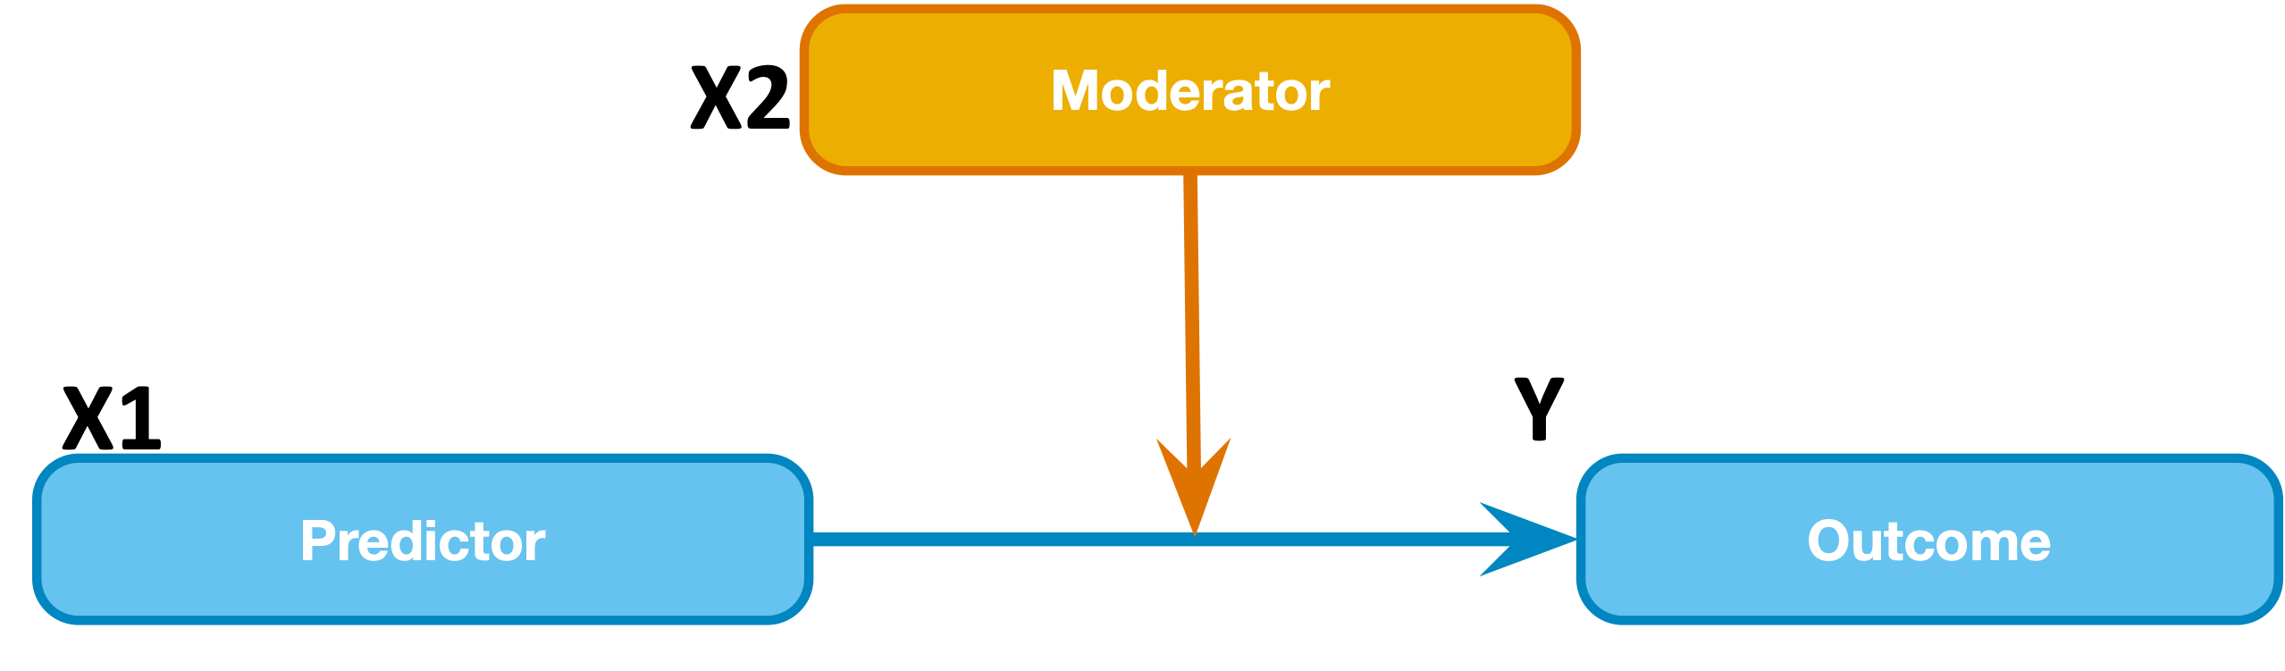
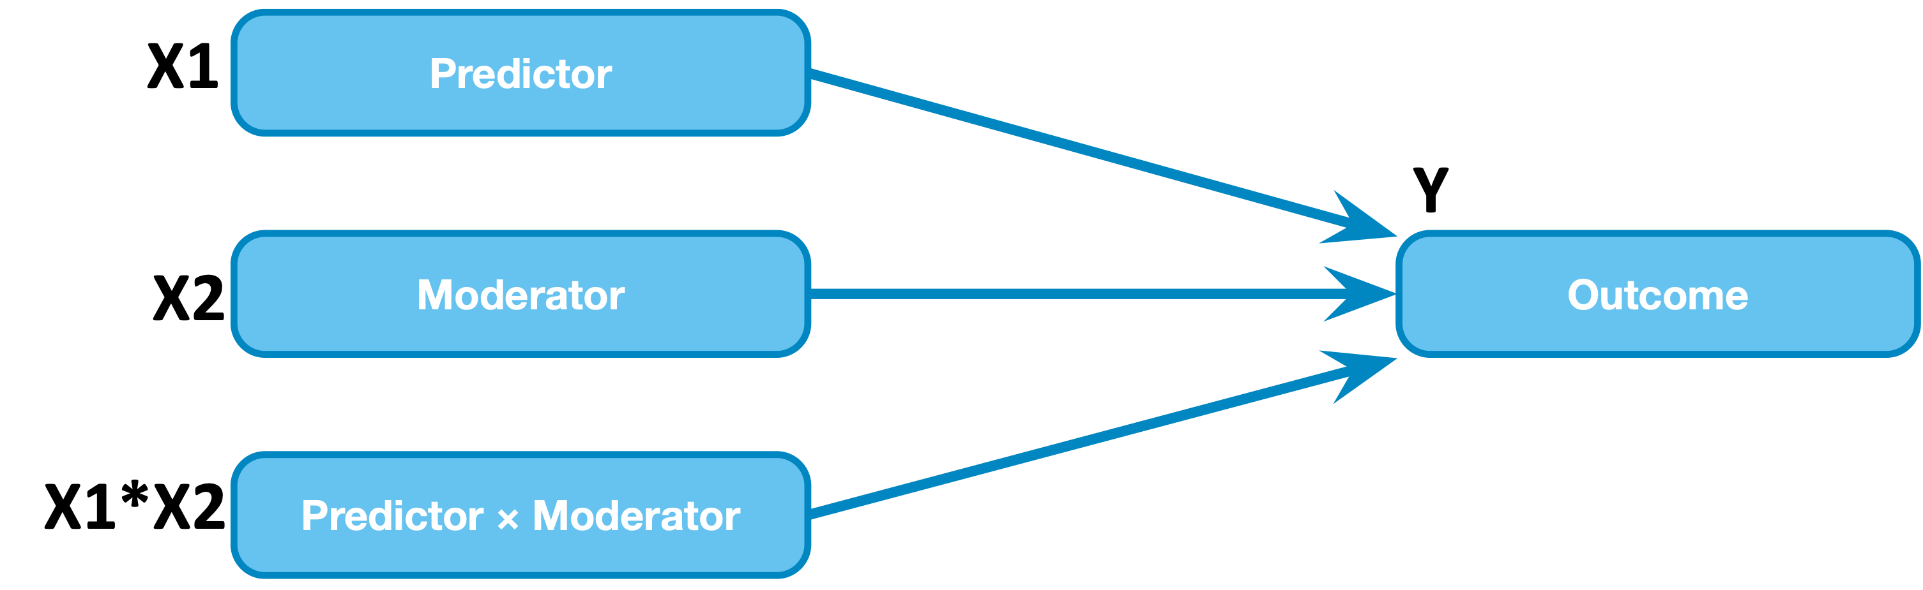
Moderation model
it’s just a single regression, with an interaction term composed of the product of two (or more) other terms
Y = b₀+b₁X1+ b₂X2 + b₃X1*X2
b₃ is the estimate of the interaction effect
A change of one unit in X1*X2 predicts a change of b₃ in Y (that’s hard to picture)

Slide 3
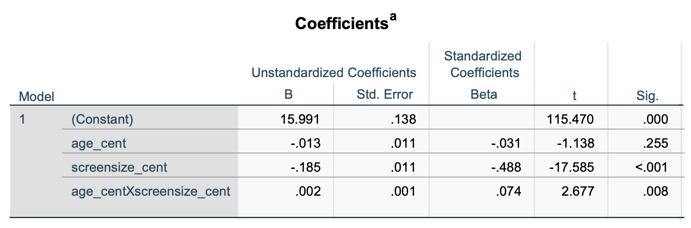
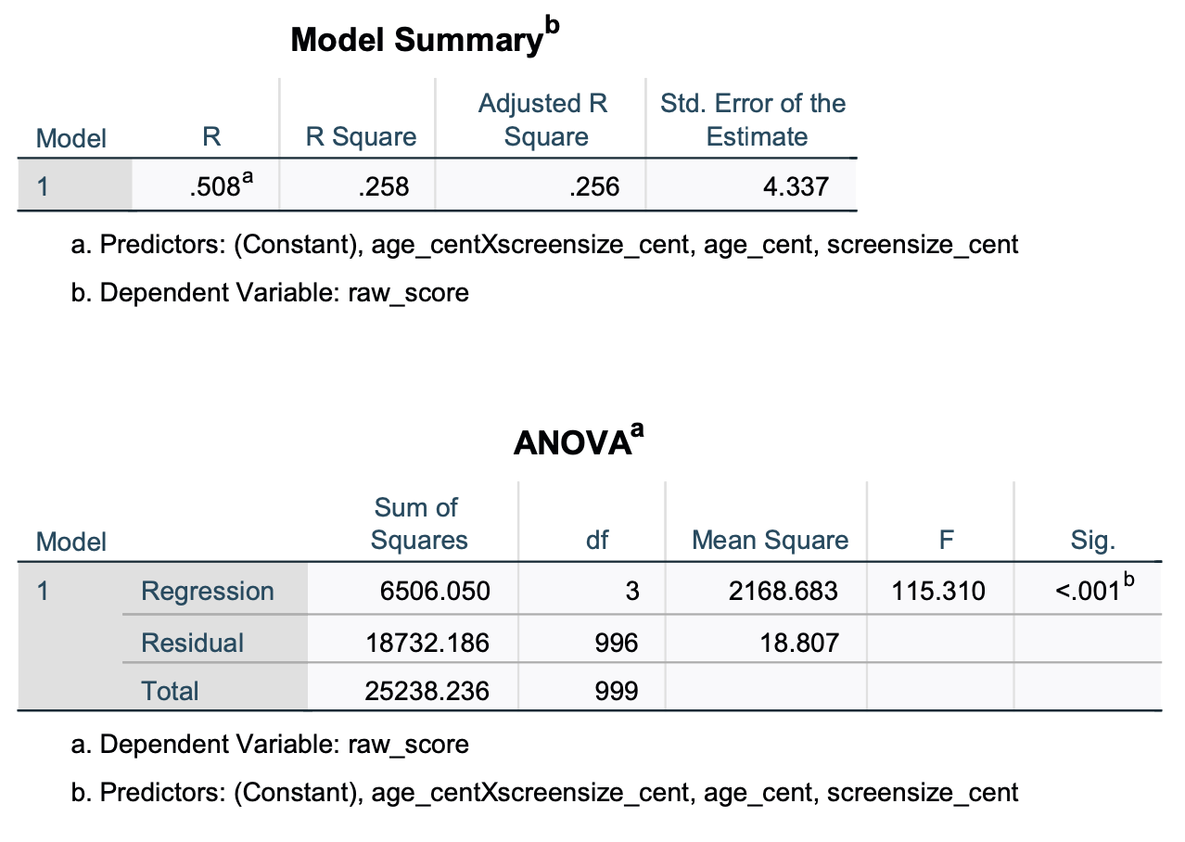
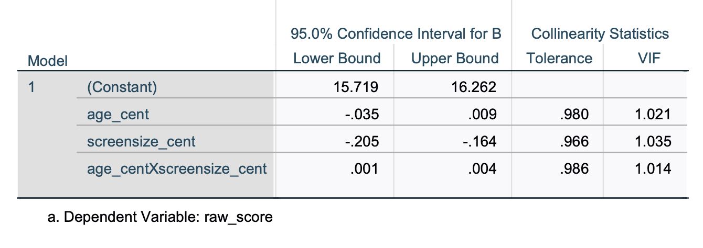
Moderation model output
SPSS linear regression – exactly the same as the lin regression output you looked at last week

Slide 4
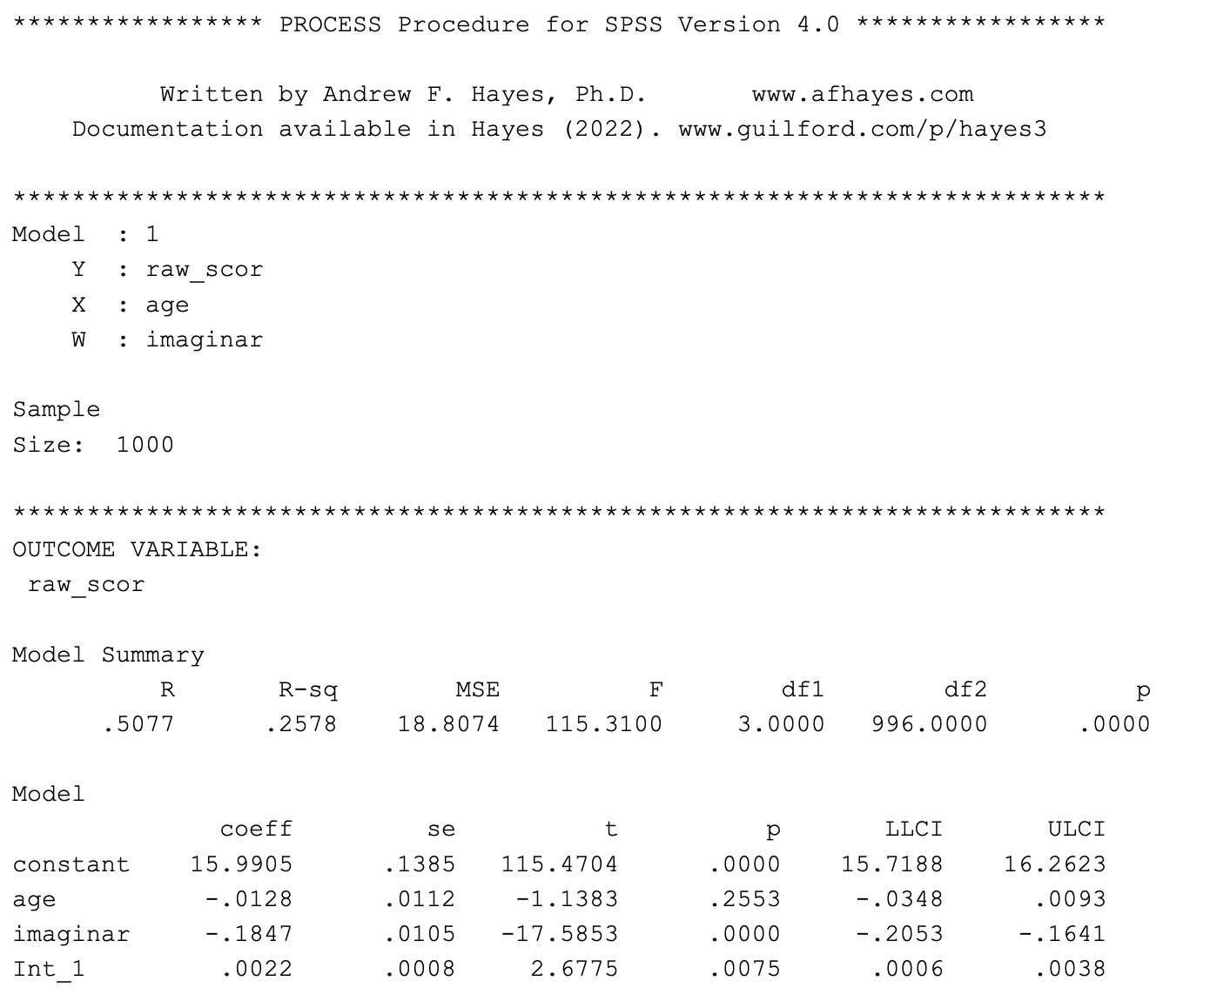
Moderation model output
PROCESS (model = 1) – same stats, reformatted

Slide 5
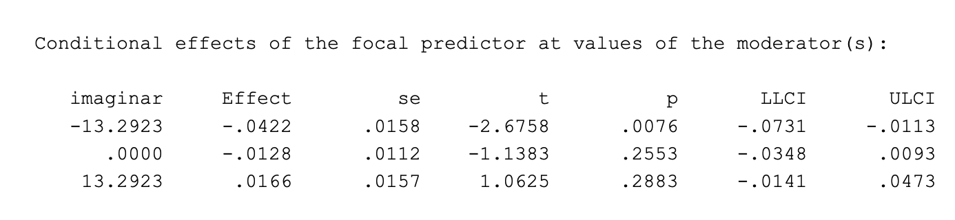
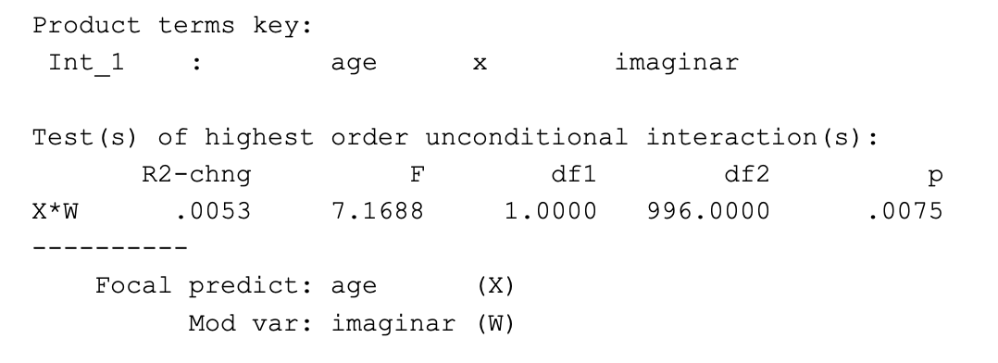
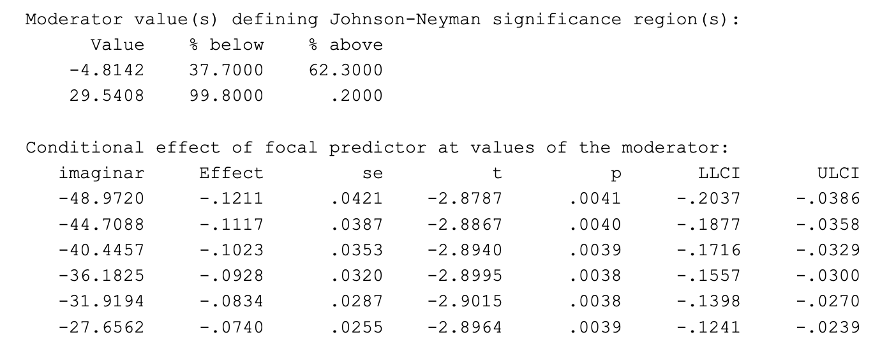
Moderation model output
PROCESS (model = 1) – stuff that is not in the regular SPSS regression output
Simple slopes (effect of X1 at distinct levels of X2)
R squared change for full model vs model w/o the interaction
X2
mean - SD
mean
mean + SD
Regions of significance (Johnson-Neyman)

Slide 6
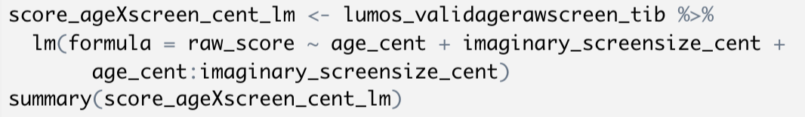
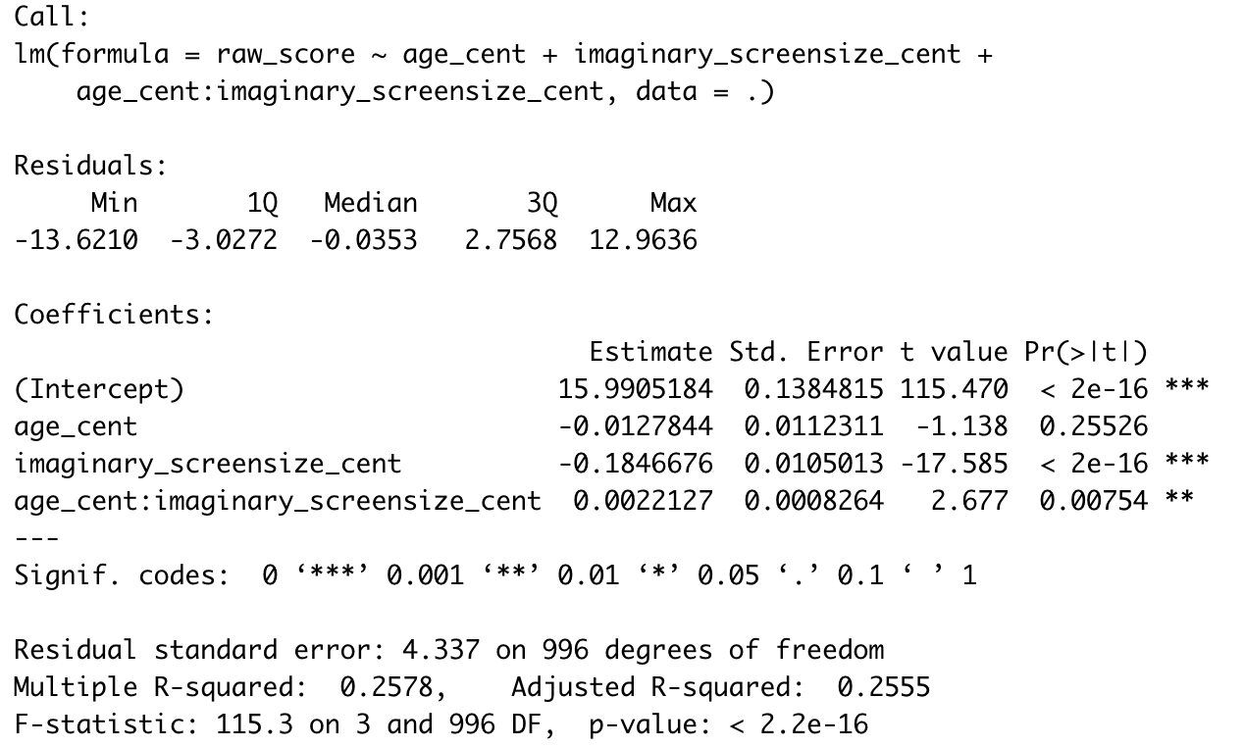
Moderation model output
R lm()– exactly the same as the output you looked at last week

Slide 7
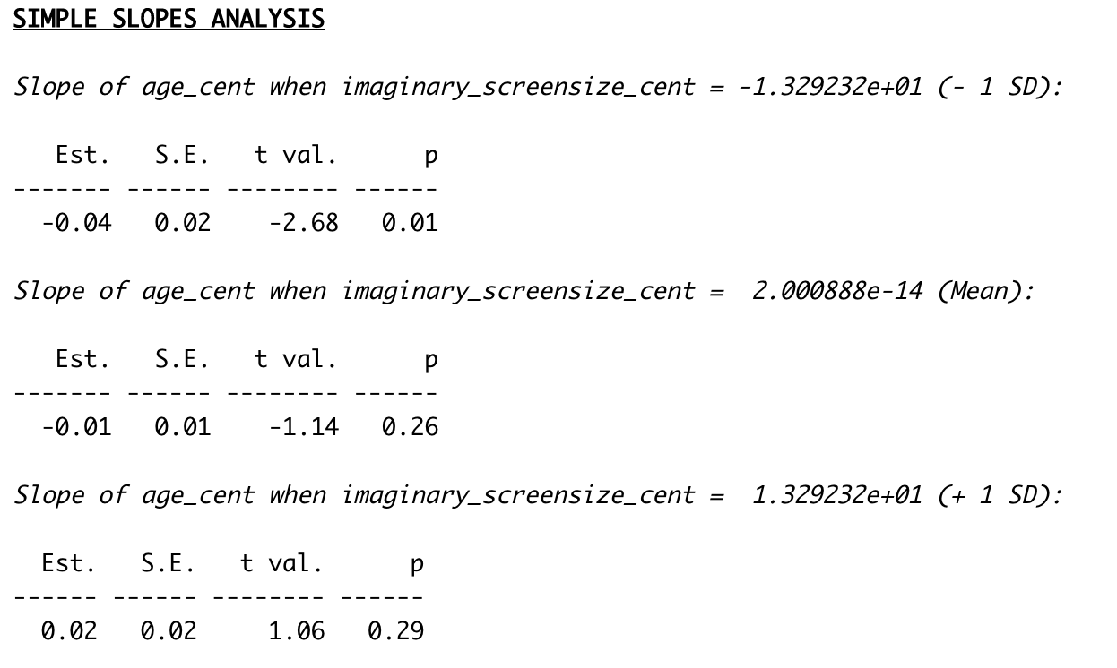
Moderation model output
R simple slopes (using interactions::sim_slope

Slide 8
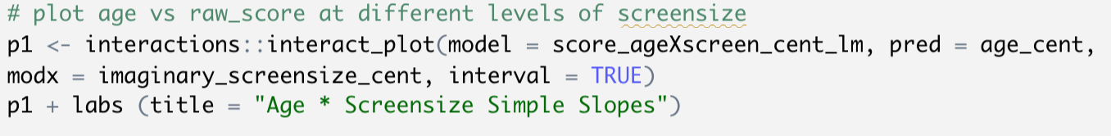
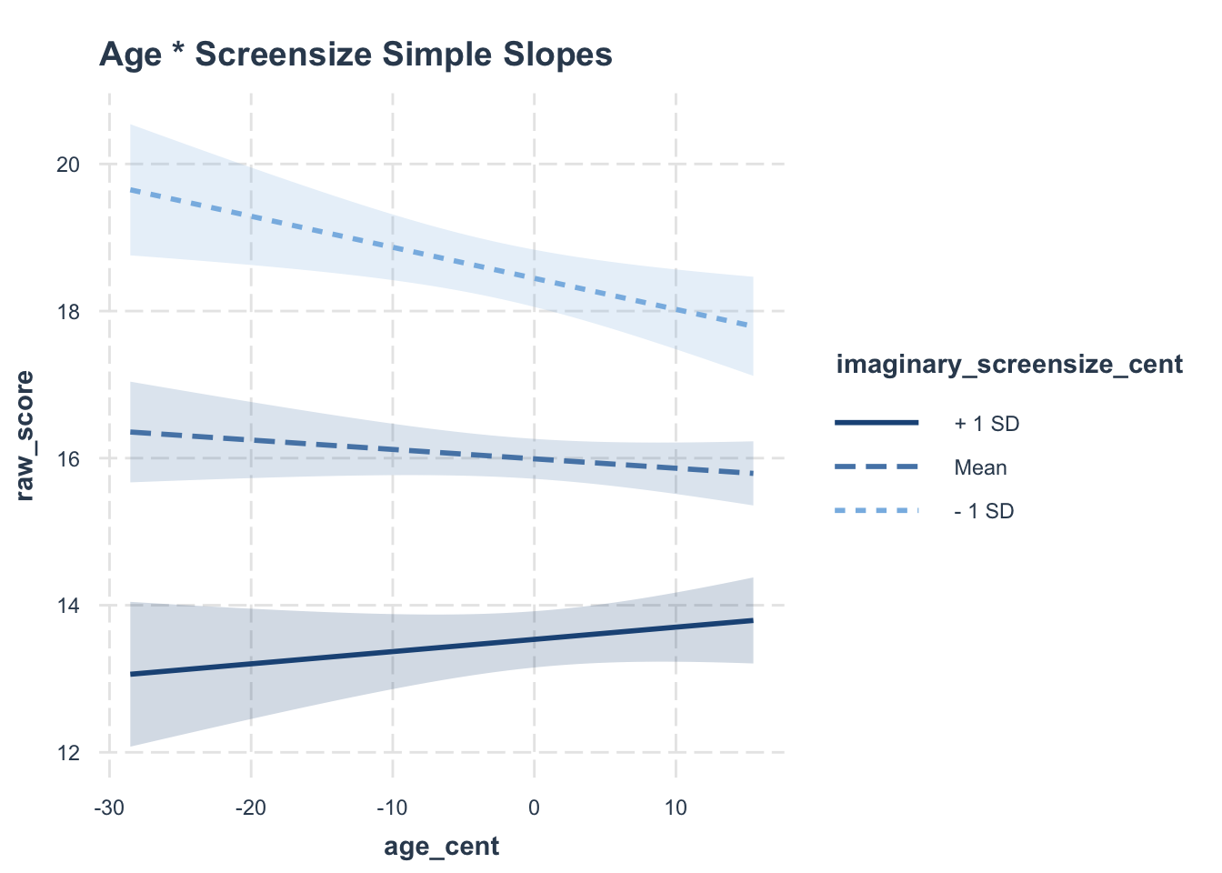
Moderation model - visualization

Slide 9
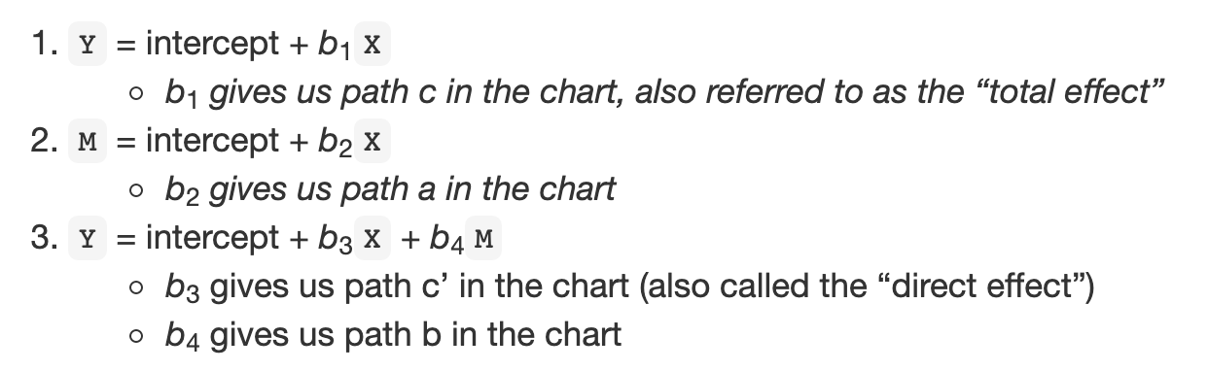
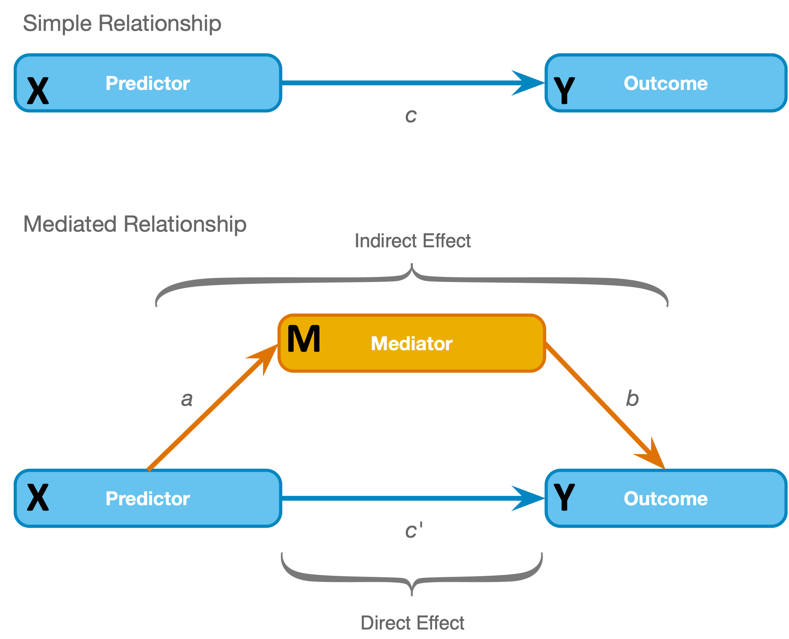
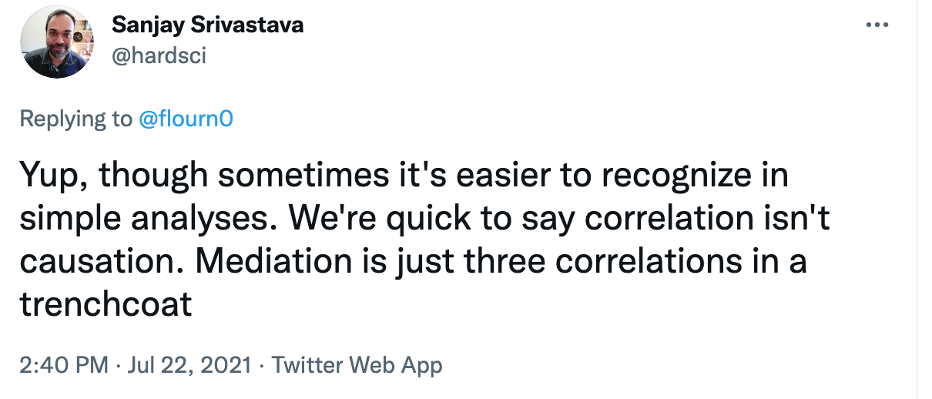
Mediation model (using PROCESS)

Slide 10
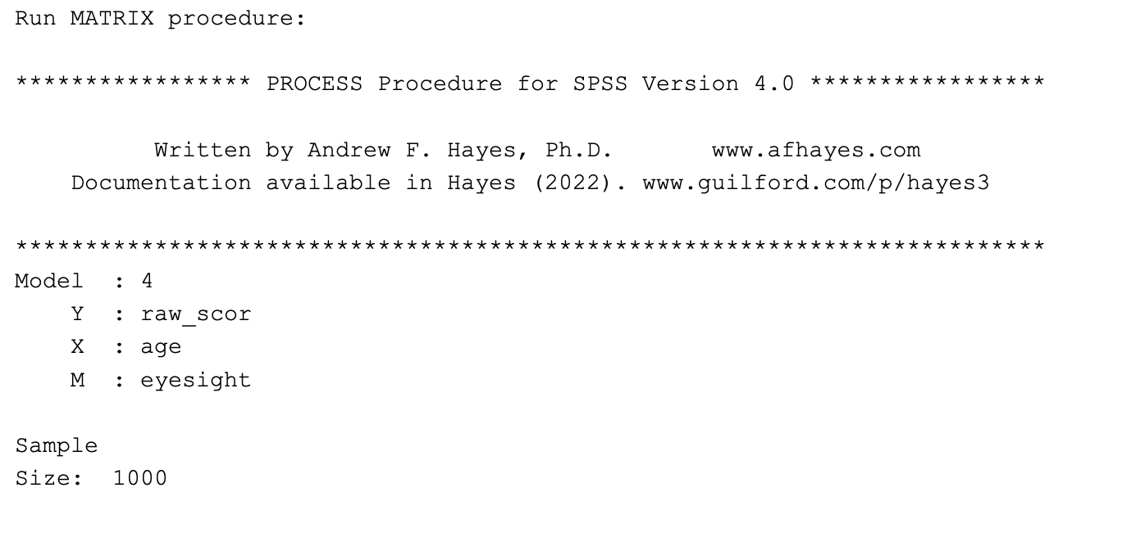
Mediation model (using PROCESS)- output
basically the same in SPSS or R

Slide 11
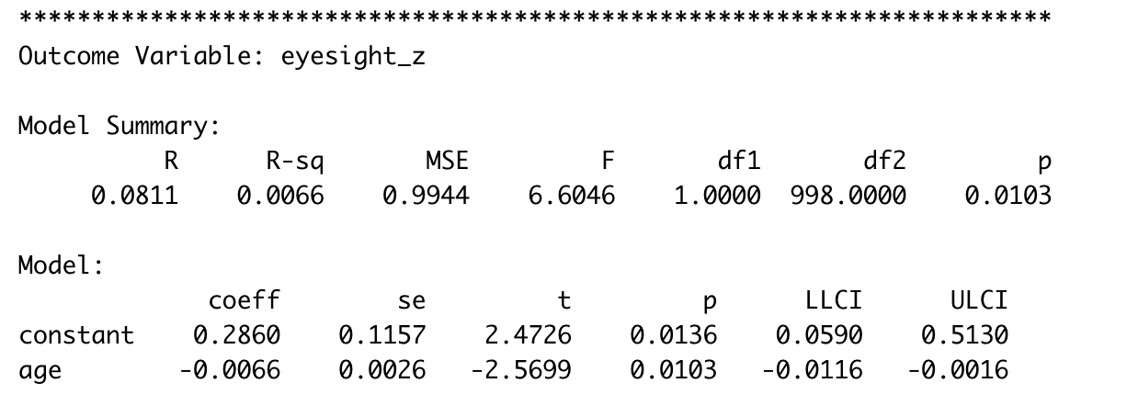
Mediation model (using PROCESS)- output
path a

Slide 12
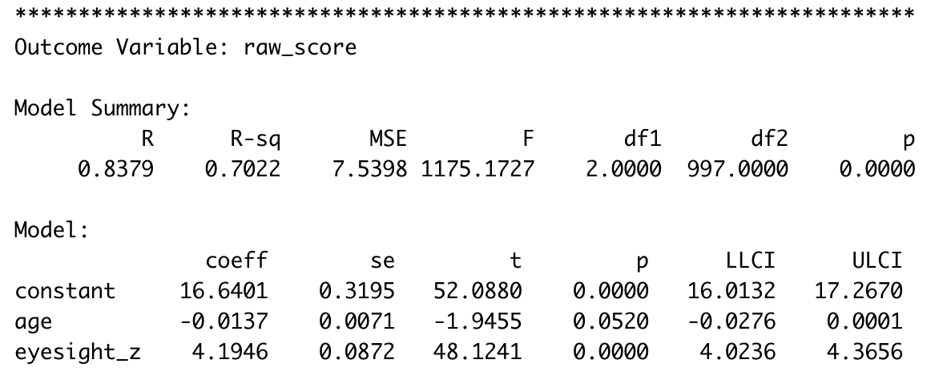
Mediation model (using PROCESS)- output
path c’
path b

Slide 13
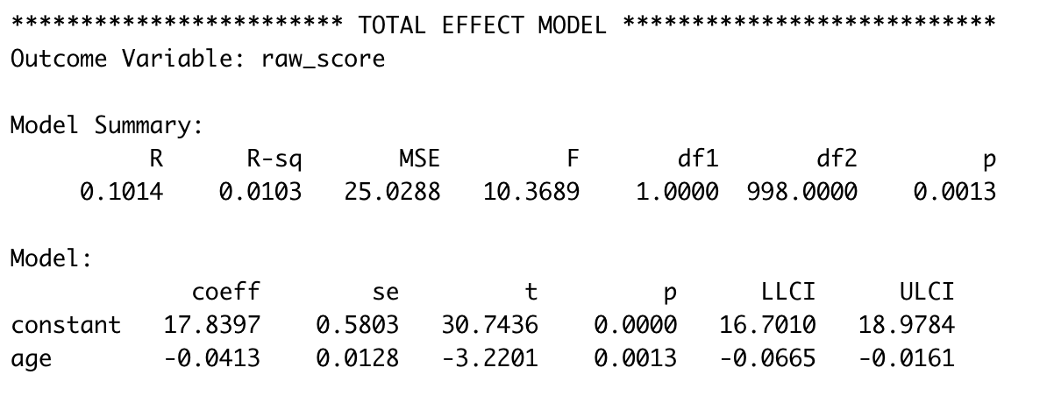
Mediation model (using PROCESS)- output
path c

Slide 14
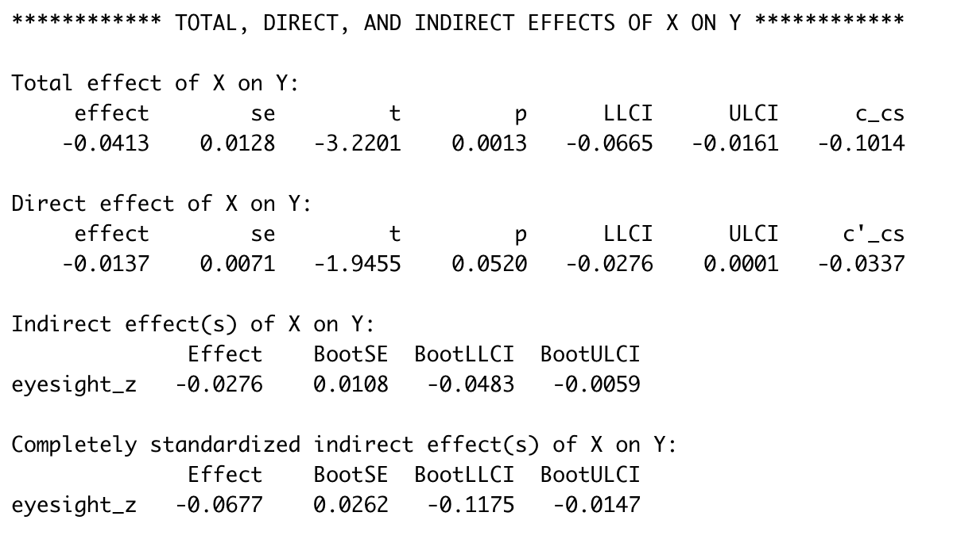
Mediation model (using PROCESS)- output
path c
path c’
path ab
path ab standardized

